Slide 1
Business English
2018
The Art of Selling
Group 6:
张金琛、马驰、王一茜、申继宁、刘润

Slide 2

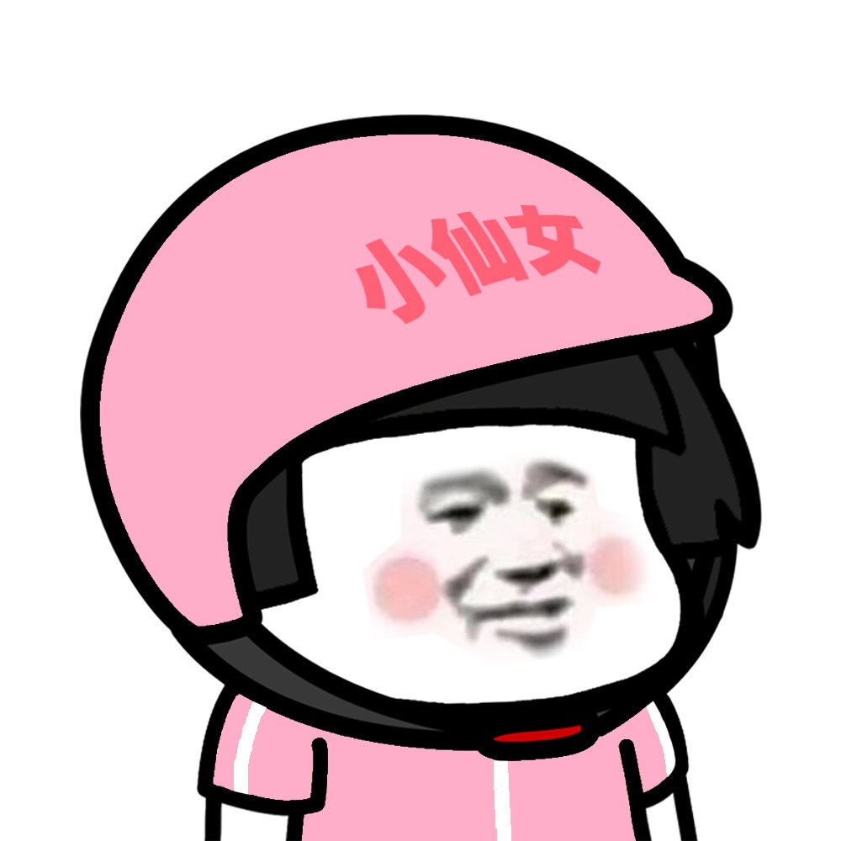
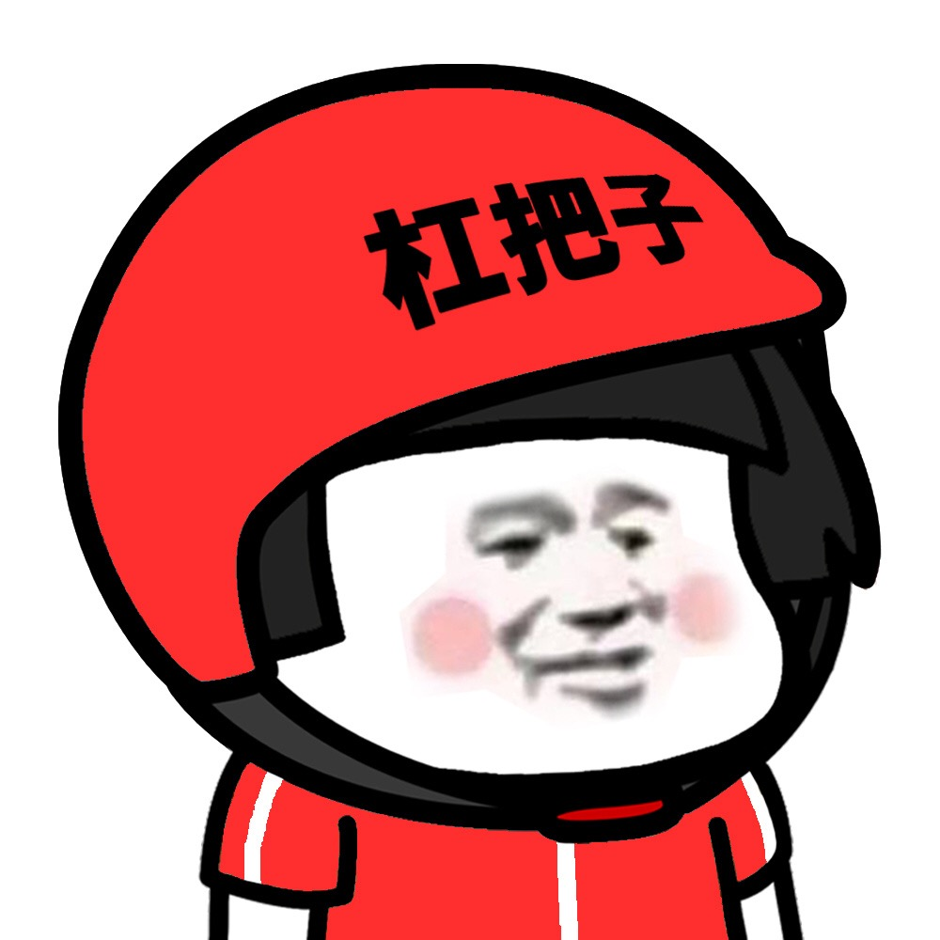
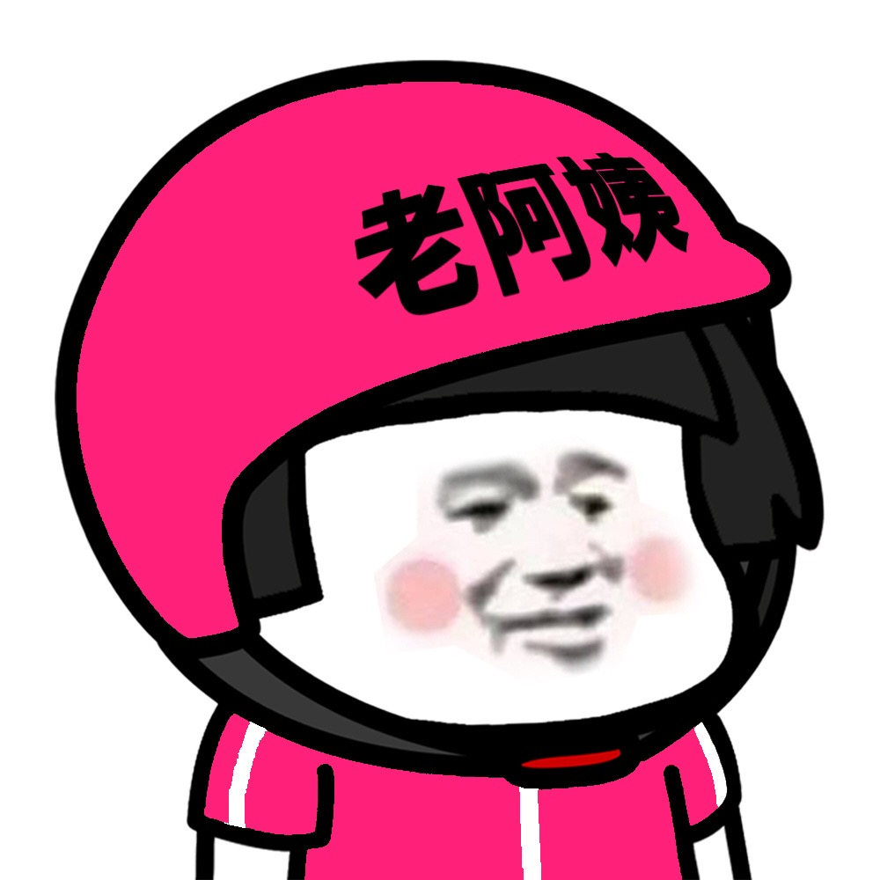

Members
JinChen Zhang
Chi Ma
YiXi Wang
Run Liu
JiNing Shen

Slide 3
1
Lipstick sales
Contents
2
Amway Promotion Venue
3
Wechat-business
4
Conclusion

Slide 4
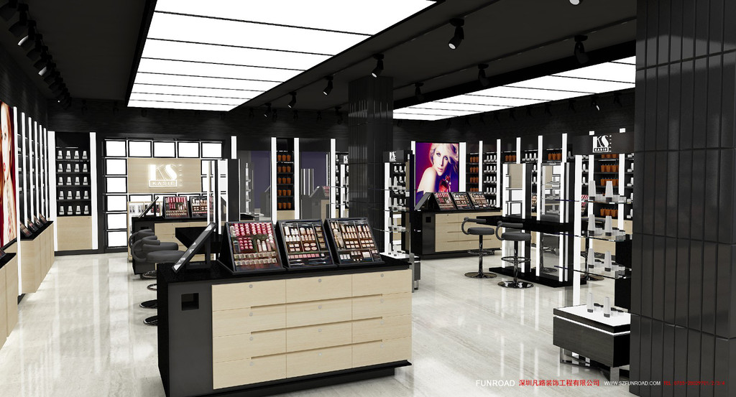
Saphora Indoor

Slide 5





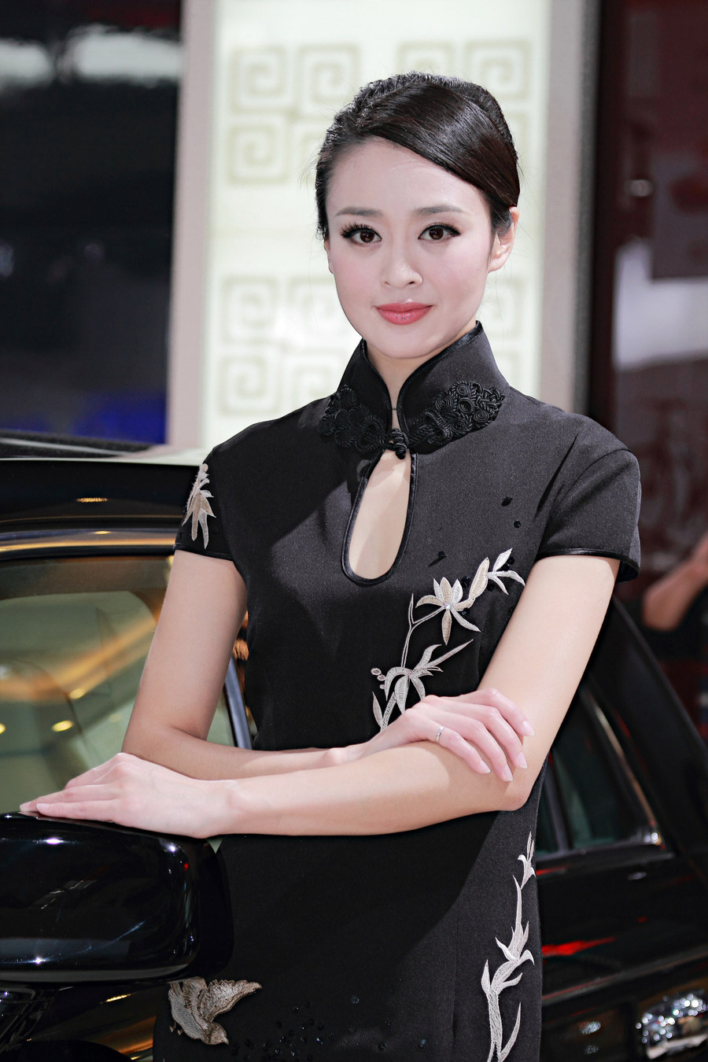

Selling Skills
professional
dignified
cordial
tidy
soft
elegant

Slide 6
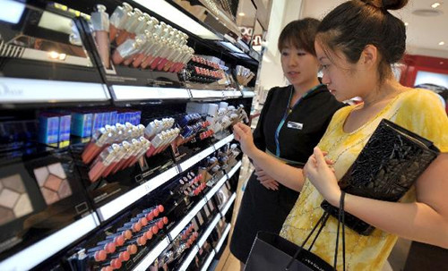
Selling Skills
understand needs
Recommend products
make a deal

Slide 7
1
Lipstick sales
Contents
2
Amway Promotion Venue
3
Wechat-business
4
Conclusion

Slide 8
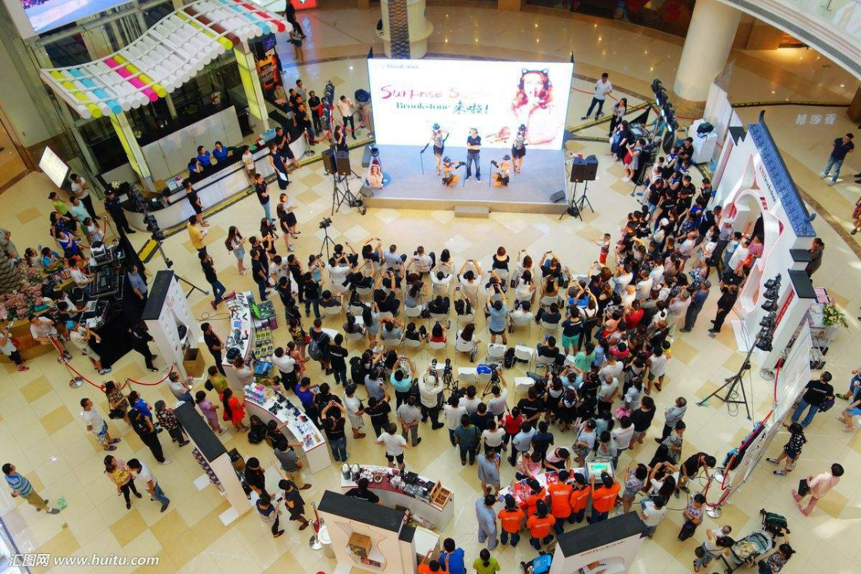
Amway Promotion Venue

Slide 9
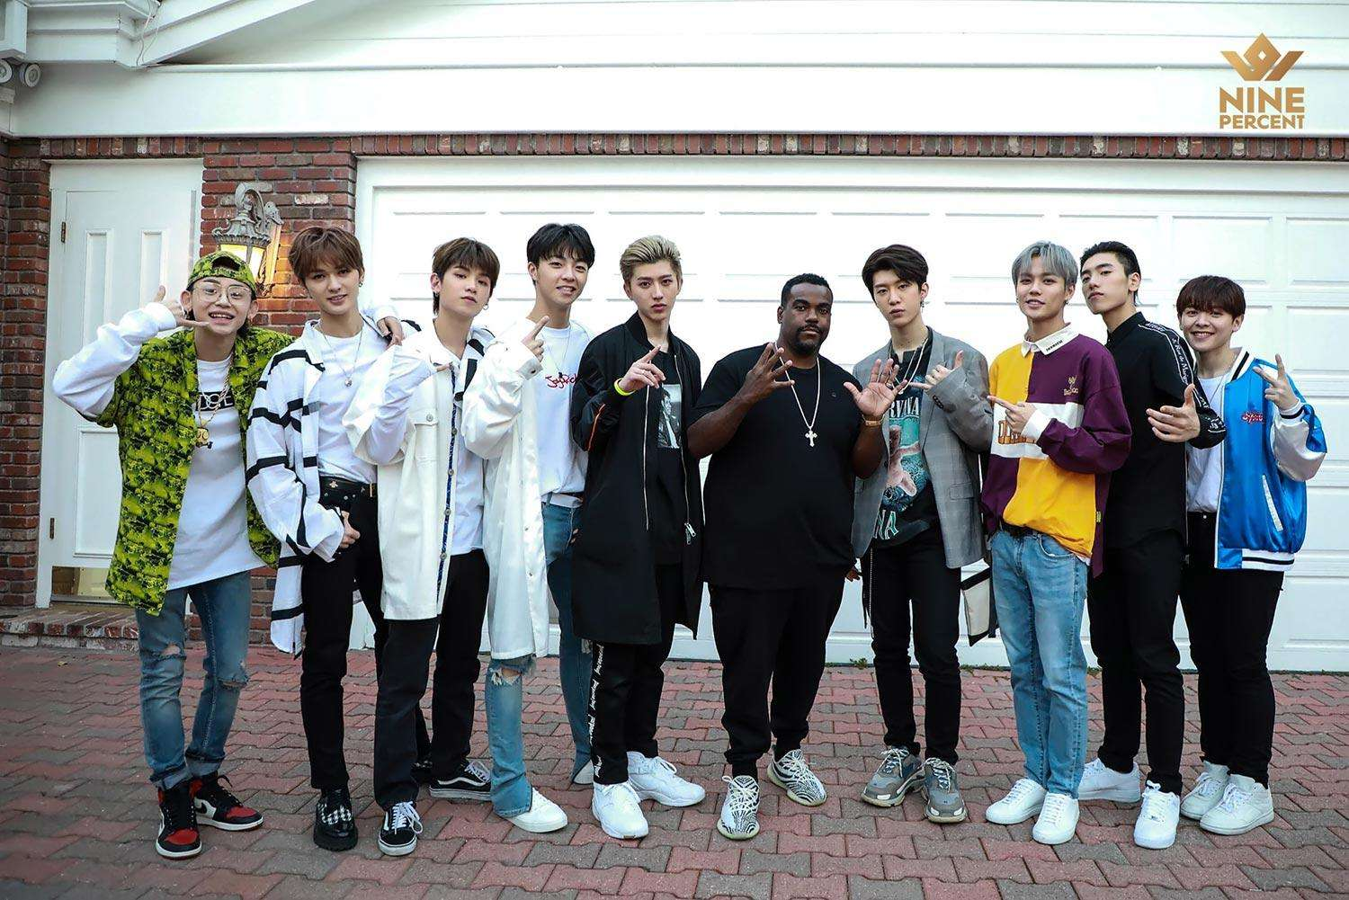


Amway Promotion Venue
Quality
In fact, the first thing I want to say is that quality is the basis.
Celebrity
Activities attract. (celebrity, reward or game)
Sincere
Talk with customers sincerely. Record the information.

Slide 10
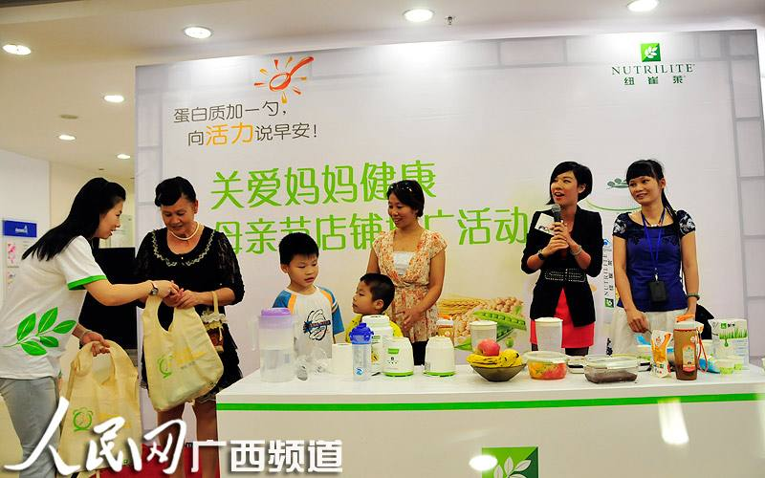
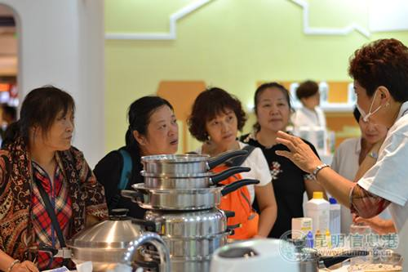
On Site Marketing

Slide 11

Make Call

Slide 12
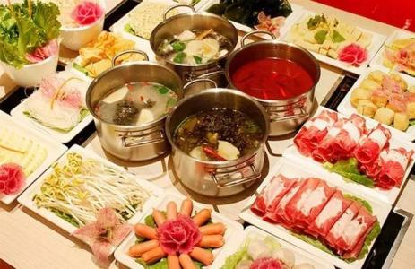
Haidilao Hotpot

Slide 13


Dear Marketing (Air Purifier)
Immediate help!
—
For all the requirements, we will give you the professional advice immediately and help u as soon as possible.

Slide 14

Selling Skills
building relationship
Selling skils
Knowing Customers need
tricks
dealing with objections

Slide 15


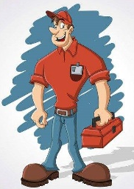
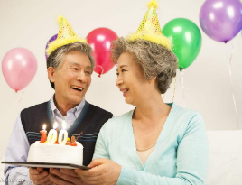


Selling Skills
quality
delivery
service
communication
member
calls

Slide 16
1
Lipstick sales
Contents
2
Amway Promotion Venue
3
Wechat-business
4
Conclusion

Slide 17
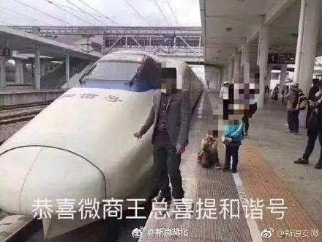
Wechat-business
Congratulations!

Slide 18

Art of wechat-business
What's the wechat-business?
Wechat social
E-commerce

Slide 19
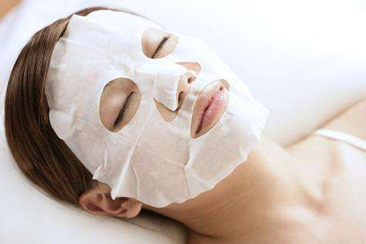


Art of wechat-business
What should we do?
team
product
2
1
3
Products
team management
Team
Management

Slide 20
Art of wechat-business
What's products should we choose?
Wide range
High repurchases
ONE
TWO
THREE
Easy to transport
FOUR
High profit

Slide 21





Art of wechat-business
How to increase connections?
Mutual recommend
With good words
Mini-video
DouYin、KuaiShou
Live broadcasts
DouYu、HuYa

Slide 22
Art of wechat-business
1
How to expand scale?
[ AIM ]
2
How to develop ur own agency?
Agent structure tree
3
How to get more money?

Slide 23


Art of wechat-business
How to find accurate consumer?

Slide 24
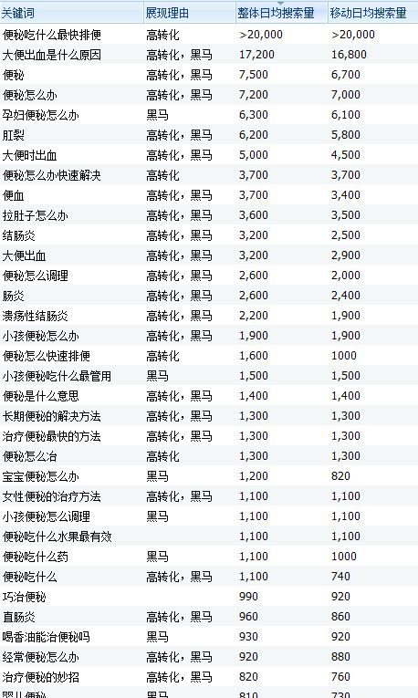
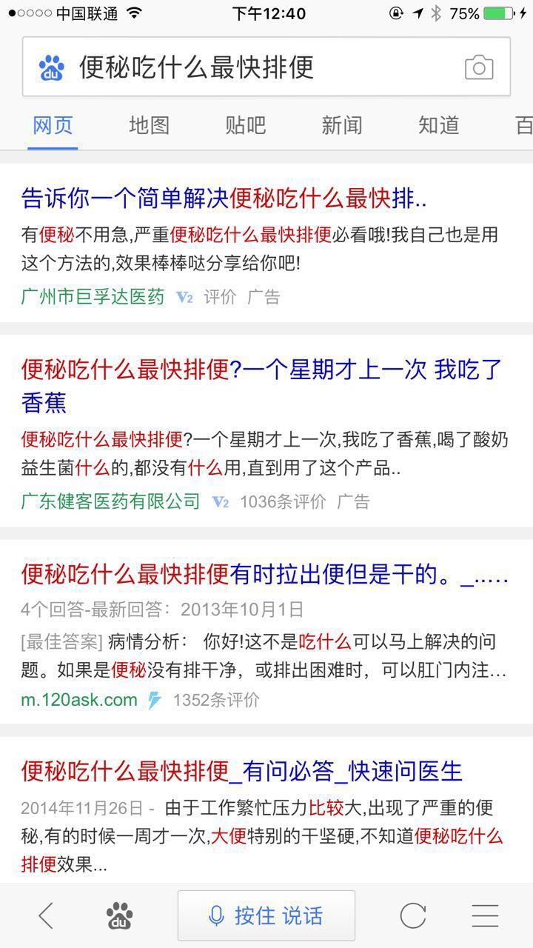
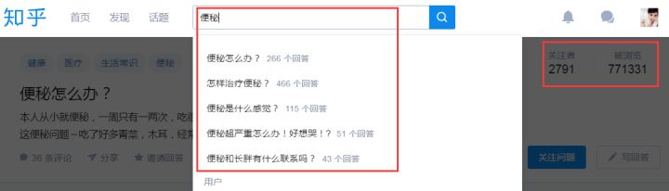
Art of wechat-business
How to find accurate consumer?

Slide 25
1
Lipstick sales
Contents
2
Amway Promotion Venue
3
Wechat-business
4
Conclusion

Slide 26
Business English
2018
Thank u for watching
汇报人：Group6
日期：2018年5月25日

